Slide 1
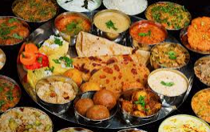
Food our fuel

Slide 2
What is in the food?
What does ‘Healthy food’ mean to you?
What does ‘unhealthy food’ mean to you?

Slide 3
MACRONUTRIENTS | MICRONUTRIENTS
Nutrients that our body needs in large amounts | Nutrients that our body needs in small amounts
Proteins, carbohydrates and fats | Vitamins and minerals
They provide our body with energy, They help our body grow and heal wounds | They help our body fight against diseases and keeps our body healthy
Nutrients

Slide 4
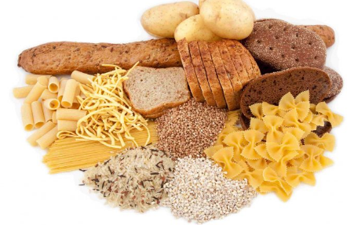
Components of food
Carbohydrates
Carbohydrates provides energy to our body
Carbohydrates are called energy-giving food
Healthy sources
Cereals(rice, wheat , oats)
fruits(banana, orange, strawberry, orange, apple)
vegetables( carrot, potato, beetroot)
honey
Unhealthy sources
Pastries, biscuits, colas, chocolates, cream

Slide 5
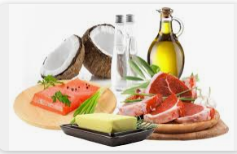
Components of food
Fats
Fats provide more energy than carbohydrates, Fats are also energy-giving food
Keep our body warm
Our body stores excess fat as a store of energy
Healthy sources
Oils, nuts and seeds
Unhealthy sources
Pastries, biscuits, cookies, doughnuts, fries, packaged foods

Slide 6
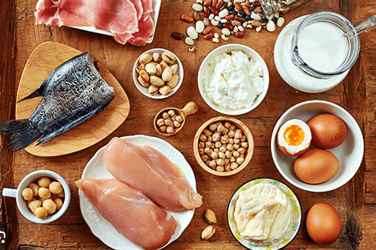
Components of food
Proteins
Proteins are body building foods
They help to build our body and repair mechanisms
Plant sources
Nuts, beans, seeds, spinach and greens, peas, lentils
Animal sources
Dairy products, egg and meat of animals

